Slide 1
XYZ_20180122_cell_1_2

Slide 2
Total number of cells: 7417
Total reads
After filtering
After trimming
Uniquely mapped

Slide 3
Total number of cells: 7417
Total number of human reads: 1084751
Total number of mouse reads: 346545

Slide 4
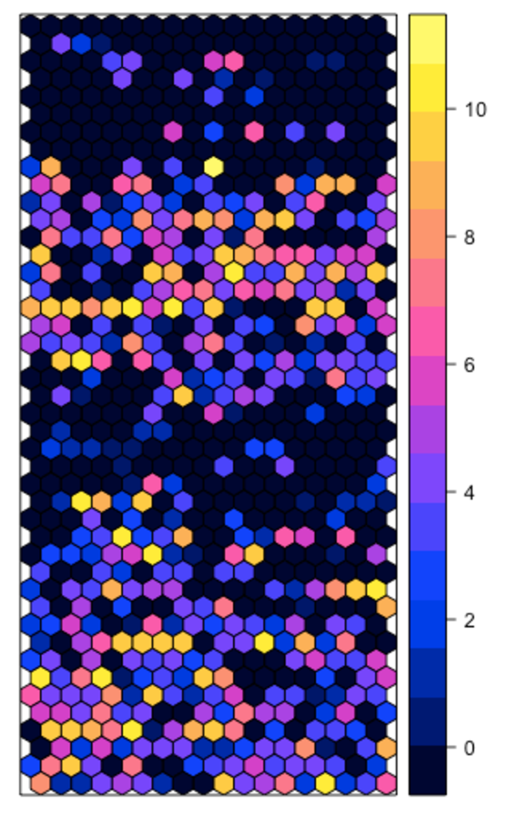
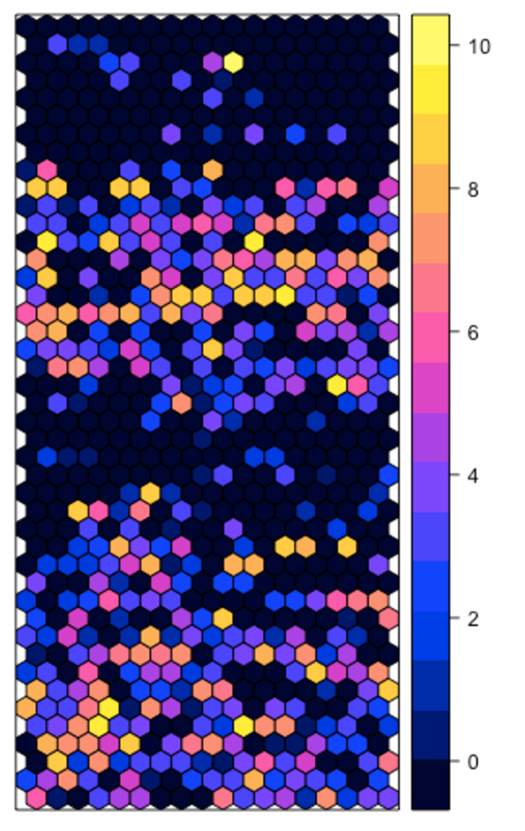
Log(Read Number) Human
Log(Read Number) Mouse

Slide 5
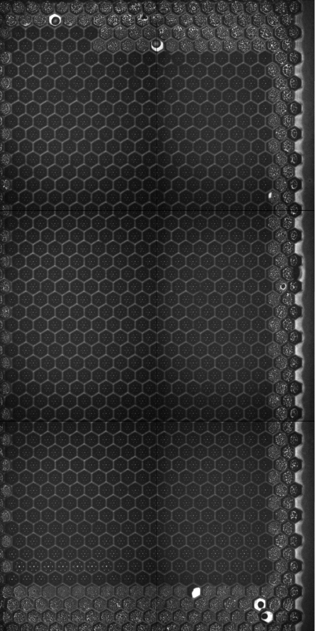
Spatial wells

Slide 6
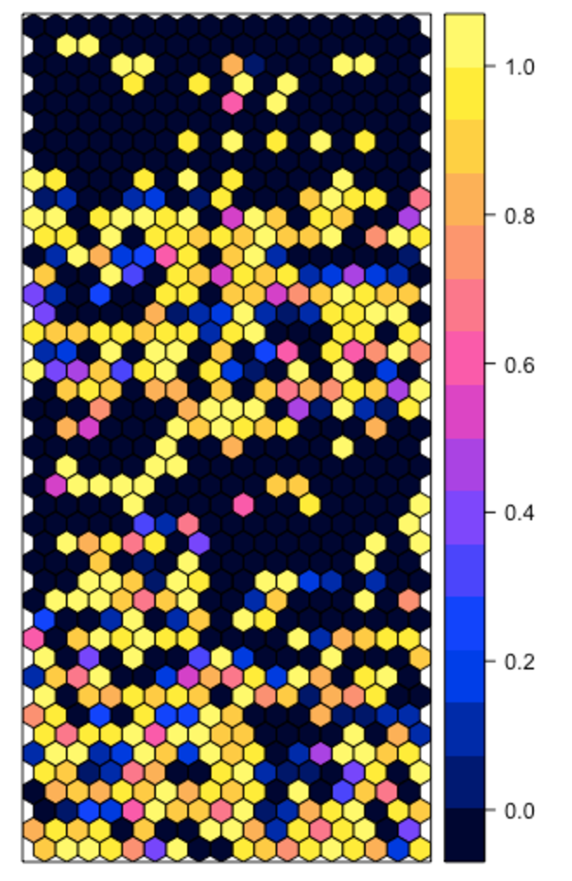
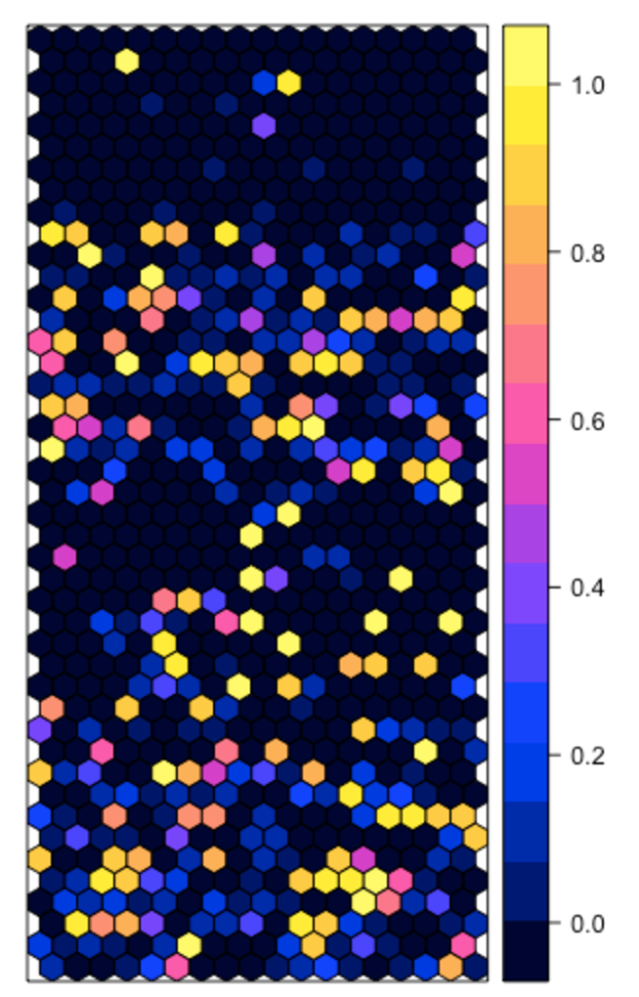
Proportion of human reads
Proportion of mouse reads

